Slide 1

Using Plain Language To Tell Our Stories
Use templates to craft simple stories with purpose.
July 14, 2021
(Storytelling for Unnatural Storytellers)

Slide 2
Today’s Workshop
Innovation Adoption at the Centers of Excellence + New COP!
What a Story Is & Why Storytelling Works
Ingredients of a Story
How to Assemble a Story
Objective: Achieve a working knowledge of story, story ingredients, and story construction to underpin successful use of story templates on your own
Notes:
Most templates I provide today are super simple. You can do most of them on a whiteboard, with sticky notes, or scrap paper.
Think of them as mini-tools for your storytelling toolkit.
I do a 4-part workshop series with more complete templates all unified into a comprehensive process. That’s not what we are doing today; today is a sampler.
May be info overload. I always pack in a lot.
Bestselling author, Robert McKee explains, “All stories are narratives. But, not all narratives are stories.”

Slide 3
Overview
ABOUT THE CENTERS OF EXCELLENCE
GSA’s Technology Transformation Services
ARTIFICIAL INTELLIGENCE
Established in 2017, in coordination with the White House Office of American Innovation, to accelerate IT modernization at federal agencies by
leveraging private sector innovation and government services
centralizing best practices and expertise across six functional areas
targeting holistic transformation.
DATA & ANALYTICS
INFRASTRUCTURE OPTIMIZATION

Slide 4
Innovation Adoption
We assess and address culture, conditions, and capabilities
to accelerate IT modernization and
successfully drive change now and in the future.
Notes:
We promote storytelling because it’s important for prompting and reinforcing changes in work processes and work culture.
I learned storytelling as a way to communicate performance information. What was working, what wasn’t. To rally people around mission, goals. To prompt performance improvements.
I learned about storytelling because I was frustrated at my inability to sway opinion with all my logic and well-prepared tables, charts, graphs, and passionate explanations on what is possible or who else has successfully done something similar.
I learned storytelling mechanics because I am bad at it.

Slide 5
Why do YOU care
about storytelling?
CHAT

Slide 6
What a Story Is &
Why Storytelling Works
“an account of imaginary or real people and events told for [entertainment]”
- Oxford Definitions
The 2 things a story must do
A bit about the neuroscience of stories
Notes:
Use stories when the stakes are high or the thing you are trying to do is important

Slide 7
What 2 things
must a story do (for your audience)?
CHAT

Slide 8
The 2 Things a Story Must Do
BONUS!
Capture and hold our attention
Transport us to the character’s world
[Insert your specific purpose here]
Notes:
Think of these as conditions or criteria. These are the initial tests of success in your storytelling.
Capture & Hold:
structure - story, sentence
communication techniques - pause, visual aids, channel
language - word choice, formality/informality, verbs, style
Transport:
a glimpse
a visit
an immersion

Slide 9
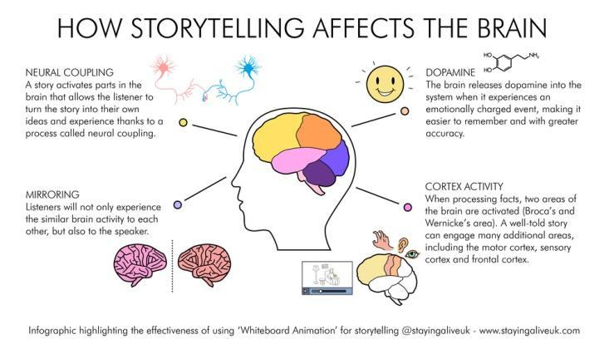
How Storytelling Affects the Brain
Notes:
Stories activate multiple parts of the brain, including those responsible for learning, memory, and emotion.
Neural Coupling: A story activates parts of the brain that allows the listener to turn the story into their own ideas and experience thanks to a process called neural coupling.
Mirroring: Listeners will not only experience the similar brain activity to each other, but also to the speaker.
Dopamine: The brain releases dopamine into the system when it experiences an emotionally charged event, making it easier to remember and with greater accuracy.
Cortex Activity: When processing facts, the two areas of the brain are activated (Broca’s (speech production) and Wernicke’s (language comprehension) area). A well-told story can engage many additional areas, including the motor cortex, sensory cortex, and frontal cortex.
Oxytocin is incredibly important to storytelling because, as we know, stories change our behavior. When our brains encounter a good story, oxytocin is released, causing us to feel empathy. The empathy is what causes us to want to take action.
it is impossible for a fully-functioning brain to make a decision without engaging parts of the brain that regulates emotion. Blending facts into story provides the right balance for the reader or listener to:
Pay attention and keep paying attention
Be transported into the character’s world

Slide 10
Which plain language principles, guidelines or tips help you
stimulate brain activity
capture & hold your audience’s attention
transport your audience to the character’s world
CHAT

Slide 11
RECAP
What a Story Is &
Why Storytelling Works
The 2 things a story must do are
Capture & hold attention + Transport to the character’s world
Storytelling triggers brain activity that facts alone do not. More is better.
Notes:
Use stories when the stakes are high or the thing you are trying to do is important
Bestselling author, Robert McKee explains, “All stories are narratives. But, not all narratives are stories.”

Slide 12
Conceptual
Case Study
Department of Happiness! (DOH!)
Happiness District Program
Single Senior Simple Joys Grants
Let’s pretend that
we all work for this new federal agency
dedicated to promoting and ensuring access to
this unalienable right
using innovative principles & practices.
Notes:
The phrase gives three examples of the unalienable rights which the Declaration says have been given to all humans by their creator, and which governments are created to protect.
We hold these truths to be self-evident, that all men are created equal, that they are endowed by their Creator with certain unalienable Rights, that among these are Life, Liberty and the pursuit of Happiness.--That to secure these rights, Governments are instituted among Men, deriving their just powers from the consent of the governed.
Among people age 65 and older, 53% of women and 28% of men are currently single.
In the U.S., 27% of adults ages 60 and older live alone, compared with 16% of adults in the 130 countries and territories studied. PEW

Slide 13
Ingredients of a Story
The 3 ingredients of a story
Notes:
There are specific things that make stories effective - using at least one of them will help you use story better

Slide 14
What 3 things
must a story include?
(think necessary ingredients)
CHAT

Slide 15
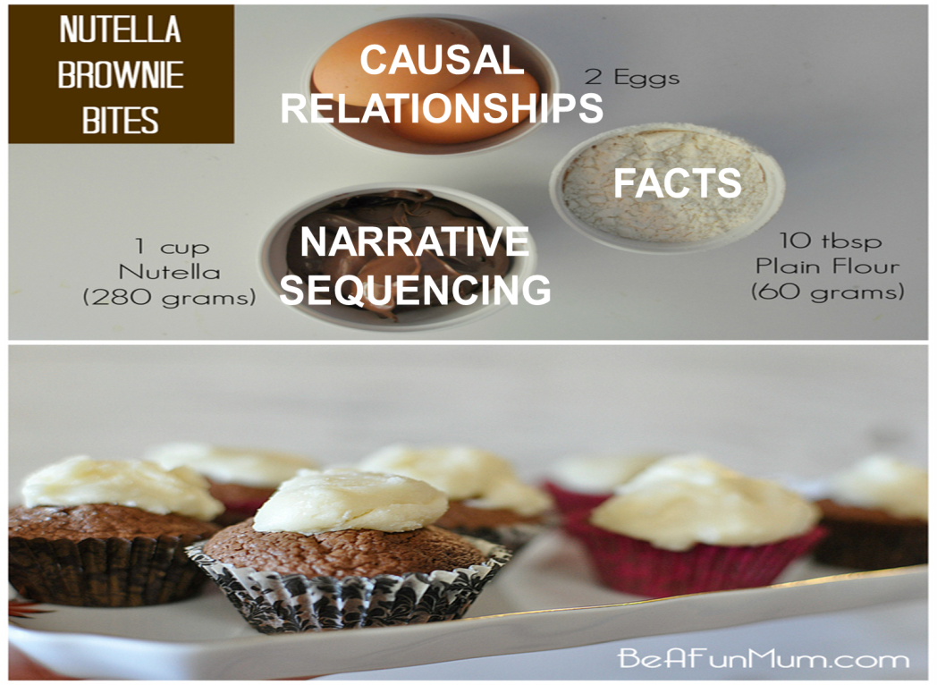
Main Ingredients of a Story
Key Facts: List related and coherent
Casual Relationships: Tie facts together
Narrative Sequencing: Order causal segments
Notes:
There are three main ingredients that all work together to make a story. Before you start drafting your first line, just assemble your ingredients.
Story Facts - typically related and coherent collection of things you know and that are relevant. You won’t need all of them, but start by brainstorming what you know and what you have evidence for.
Causal Relationships - tying the facts together which can be done using associative pairing or a messy system of boxes, circles, lines and arrows. For complex stories, or stories with high stakes, define your cause-effect relationships using some of those story facts you generated.
Narrative Sequence - telling causal or temporal segments one at a time which can be done using sticky notes (onto a storyboard), an outline, or story arc. This is where you begin to string together those cause-effect relationships.
ALTERNATIVES EXIST!
3 Ingredients of a Story
Characters
Conflict
Closure

Slide 16
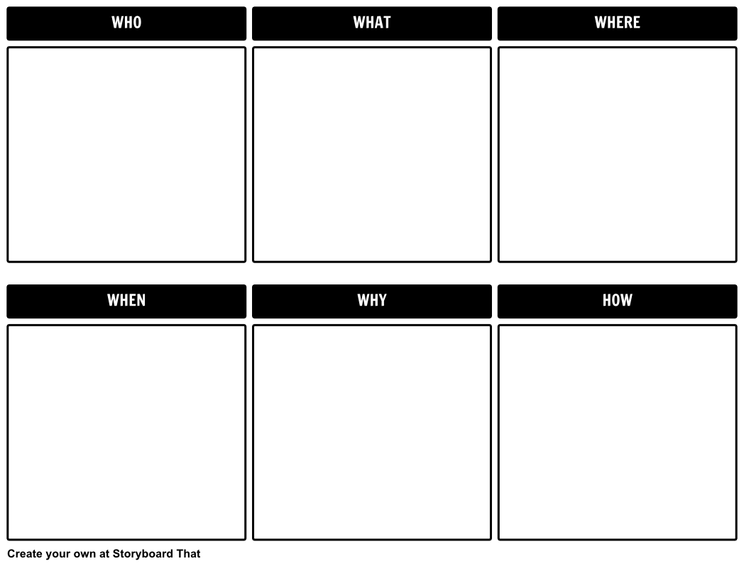
What counts as
a Fact?
TIP
You can list WAY more facts than the audience needs to hear/read.
Edit ruthlessly.
Notes:
Something you can see, hear, touch, feel, know, prove

Slide 17
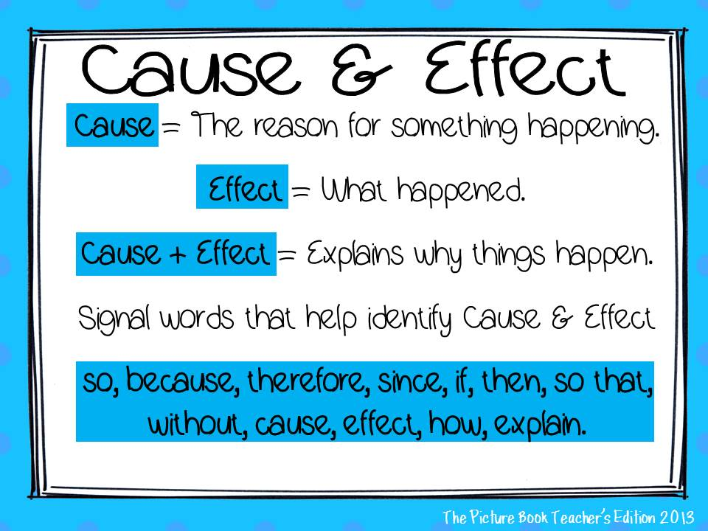
Cause and Effect

Slide 18
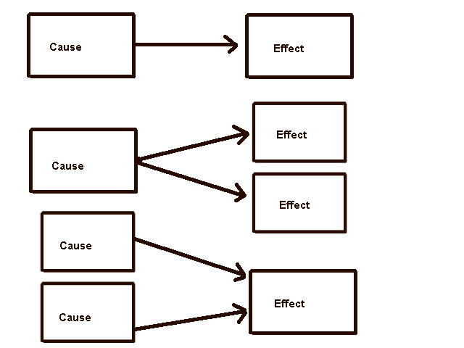
Root Cause Diagrams
Notes:
build them out like root cause diagrams

Slide 19
RECAP
Ingredients of a Story
The 3 ingredients of a story are
Facts + Causal Relationships + Sequencing
TIP
Measure out your ingredients before you start assembling your story.
TIP
Then edit ruthlessly.
TIP
Make this your 2nd step, not your first.
Notes:
Bestselling author, Robert McKee explains, “All stories are narratives. But, not all narratives are stories.”

Slide 20
How to assemble a delicious a Story
Before you even start your story, check in with PAM (and other tools)
Purpose + Audience + Message (storytelling parameters)
Follow a recipe or reliable techniques
Assemble the 3 key ingredients (story content)
Notes:
There are specific things that make stories effective - using at least one of them will help you use story better
As mentioned, there are multiple ways to build your story. It is less important which one you use and more important that you just use one. You will be less likely to skip important steps if you follow a template.
Let’s walk through a simple guide with an example.
Pre-Story
Define your purpose - Why are you talking, writing?
Understand your audience - Who are you talking/writing to?
Craft your message - What do you want your audience to think or do differently after hearing or reading your story?
Story Construction
List some key facts.
Pinpoint your most powerful causal relationships.
Sequence your facts and causal pairing into a story arc, sparkline, or other story structure.

Slide 21
PAM: Basic
Purpose | Audience | Message
Notes:
Grease the pan before you start assembling the ingredients. Otherwise you might forget and charge forward.
Having these 3 things set in advance, you are ensuring a clean release of your story.
Purpose:
Help unnatural storytellers use story to be more effective at work
Audience:
Feds who believe storytelling is a good idea but don’t do it regularly
Message:
Use stories when the stakes are high or the thing you are trying to do is important
There are specific things that make stories effective - using at least one of them will help you use story better
Just use a template when you want to incorporate story into your work (pick at least one)

Slide 22
PAM: Lightly Guided
PURPOSE | What are you trying to accomplish? How can telling a story help you accomplish that?
AUDIENCE | Who needs to think or do something differently in order for your objective to be accomplished? What do you know about them? What do they need to know in order to think or do the thing you want them to think or do?
MESSAGE | What is so important? Why is it so important? How is your audience involved? What can they do?

Slide 23
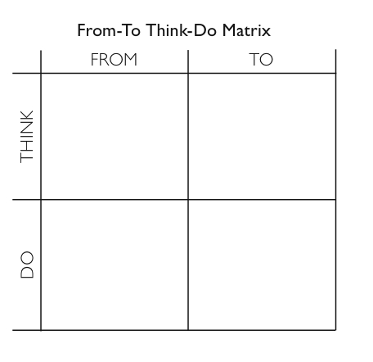
PAM: 3-in-1
Check your work!
Get specific about your purpose
Get specific about your audience(s)
Clarify your message(s)
Prepare your call(s) to action

Slide 24
Which template are you
most likely to use most often and why?
CHAT
3 Ingredients Facts Lists Cause-Effect Relationships
Basic PAM Guided PAM From/To-Think/Do

Slide 25
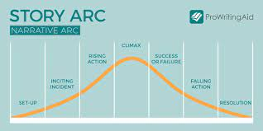
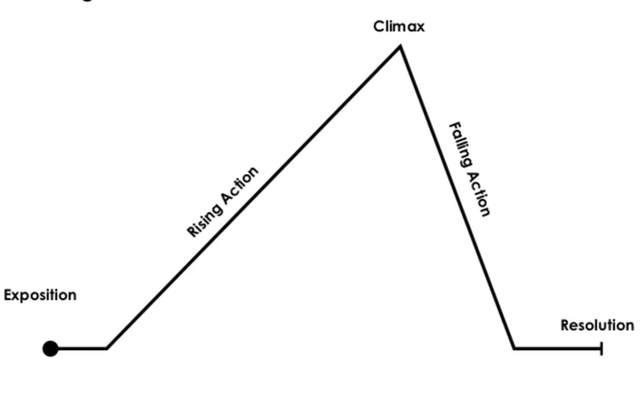
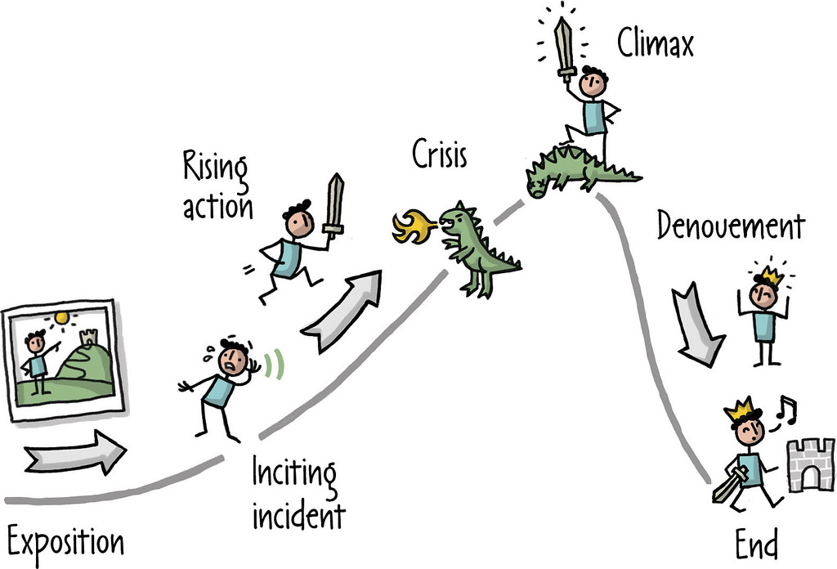
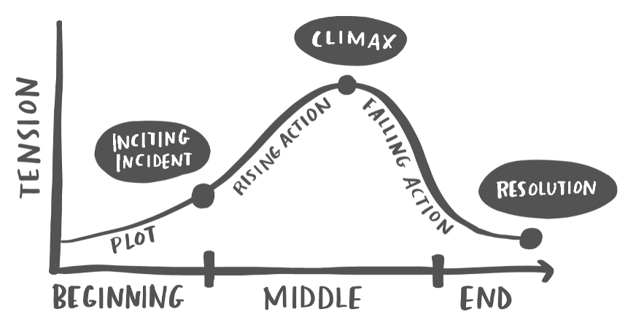
Story Arcs

Slide 26
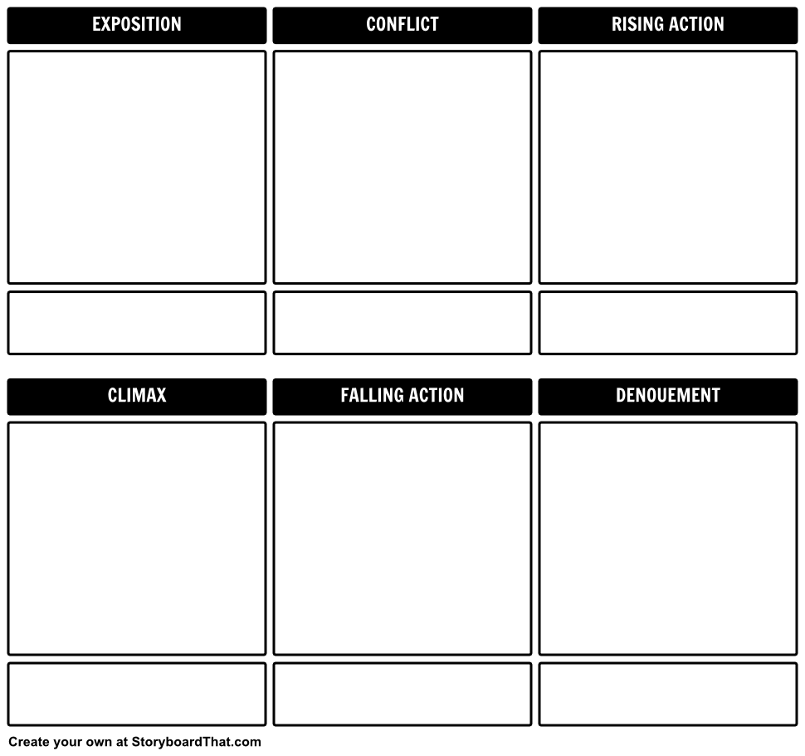
Story Boards

Slide 27
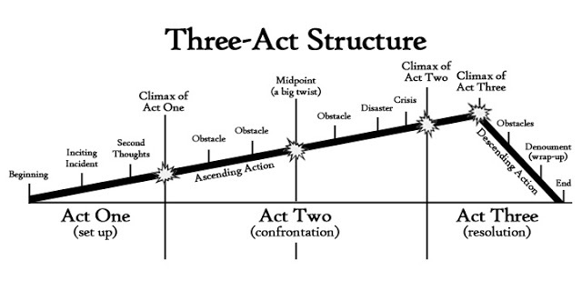
Three-Act Structure

Slide 28
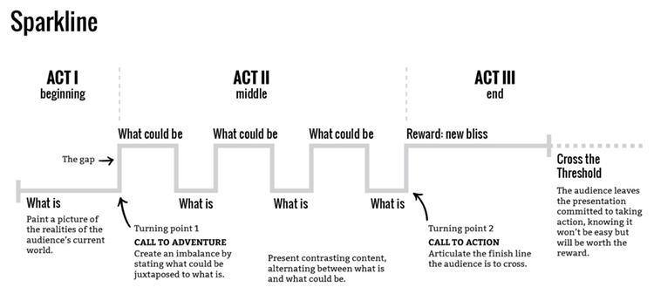
Sparkline

Slide 29
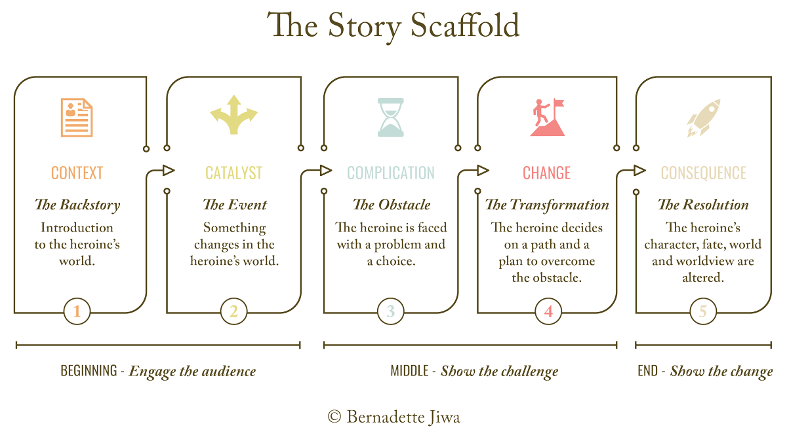
The Story Scaffold

Slide 30
5-Slide Story Guide
Slide 1 The Situation | Slide 2* The Struggle | Slide 3 Transformation | Slide 4 Progress | Slide 5 What’s Next
Problem, challenge, need Likely consequences | Partial or failed solutions Unforeseen challenges | Aha moment, lucky break Hard work paying off | New course of action Things falling into place | Projected benefits Call to action
*OK to use more than one slide on The Struggle
Notes:
SLIDE 1: Exposition/Inciting Incident - “The Situation” Describe the problem, challenge, or need using evidence and/or anecdote. This should be the ‘before state’ beginning at the start – or just before the start – of the CAP Goal cycle. Present compelling evidence and anecdotes that speak to the importance of the goal and why it was necessary to address the issue in a cross-agency manner.
SLIDE 2: Rising Action - “Your Government at Work” Describe some of the work done in the early stages of the CAP Goal period. Use evidence and anecdotes to describe the team’s efforts and interim results. Some of those results are likely to be good and some are likely to be exploratory or ineffective. Describe external factors that you learned about along the way – additional obstacles or opportunities that you had not accounted for. This slide should be about the struggle and obstacles and frustrations. It should be about the effort made that yielded minimal results. SLIDE 3: Climax - “Transformation” Describe a new situation that you affected by taking key actions that resulted in a new or revised need, challenge, or opportunity. This should be a transformational moment, such as the ‘aha moment’, ‘getting over the hump’, a ‘last straw’ that motivated a sudden change, ‘the last piece of the puzzle’ falling into place, or a significant change in the internal or external environment that allowed for greater progress than before. Reasons for the transformation may be things like new data, analysis that revealed a different perspective on the situation, or the collection of agencies really coming together like they had not before. Use evidence or anecdotes to illustrate or explain the transformation.
SLIDE 4: Falling Action - “Progress on the Issue” Describe the new course of action and results based on the transformational factors. Use evidence and anecdotes to help the reader visualize either the new activities you are engaged in or the new mode of results that are being affected for beneficiaries.
SLIDE 5: Resolution/Denouement – “What to Look for Going Forward” Describe the work that is yet to be done as well as the anticipated results. Use evidence and anecdotes to bring the anticipated actions and results to life. Include links to where the reader can go for more information or to track progress. Also reiterate the importance of the cross-agency goal and the importance of multiple agencies continuing to work together to effect results.

Slide 31
Which story template are you
most likely to for your high-stakes story?
CHAT
Notes:
macro-application: how might you use any of these story structure to guide report writing or a memo?
micro-application: embed stories into reports, memos, other content

Slide 32
RECAP
How to Assemble a Delicious Story
Start with PAM (and other tools)
Purpose + Audience + Message (storytelling parameters)
Follow a recipe or reliable techniques
Assemble the 3 key ingredients (story content)
Notes:
Bestselling author, Robert McKee explains, “All stories are narratives. But, not all narratives are stories.”

Slide 33
Review of Today’s Workshop
Innovation Adoption at the Centers of Excellence + New COP!
What a Story Is & Why Storytelling Works
Ingredients of a Story
How to Assemble a Story
Objective: Achieve a working knowledge of story, story ingredients, and story construction to underpin successful use of story templates on your own
Notes:
Most templates I provide today are super simple. You can do most of them on a whiteboard, with sticky notes, or scrap paper.
Think of them as mini-tools for your storytelling toolkit.
Bestselling author, Robert McKee explains, “All stories are narratives. But, not all narratives are stories.”

Slide 34
Thank you
Bethany Blakey
Director of Innovation Adoption
GSA - TTS - Centers of Excellence
Notes:
End Slide. This indicates the end of your presentation.

